Slide 1
Software Security Testing & Validation–2
The OWASP Software Assurance Maturity Model (SAMM) undertakes software security testing & validation during the following phases:
Verification
Deployment

Slide 2
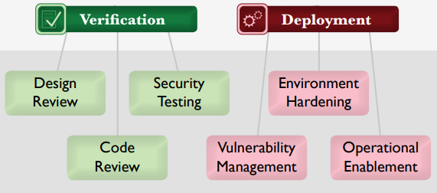
Software Security Testing & Validation–2

Slide 3
Software Security Testing & Validation–2
OWASP Software Assurance Maturity Model (SAMM) Deployment Phase:
Environment Hardening
Vulnerability Management
Operational Enablement

Slide 4
Software Security Testing & Validation–2
Environment Hardening:
Focused on building assurance for the runtime environment that hosts the organization’s software.
Since secure operation of an application can be...

Slide 5
Software Security Testing & Validation–2
Environment Hardening:
…deteriorated by problems in external components, hardening this underlying infrastructure directly improves the overall security posture of the software

Slide 6
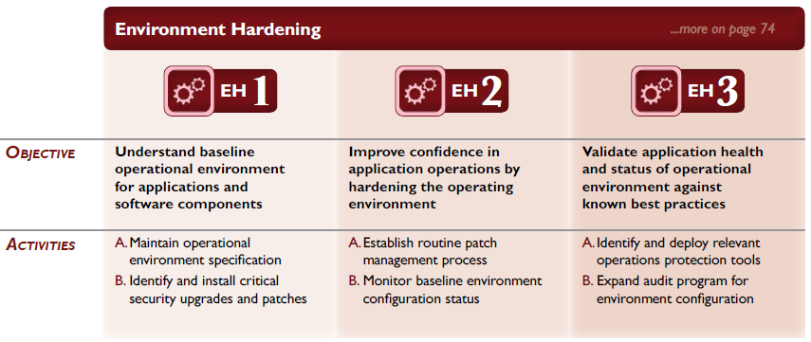
Software Security Testing & Validation–2

Slide 7
Software Security Testing & Validation–2
Vulnerability Management:
Focused on the processes within an organization with respect to handling vulnerability reports and operational incidents.
By having these processes in place, an organization’s

Slide 8
Software Security Testing & Validation–2
Vulnerability Management:
…projects will have consistent expectations and increased efficiency for handling these events, rather than chaotic and uninformed responses.

Slide 9
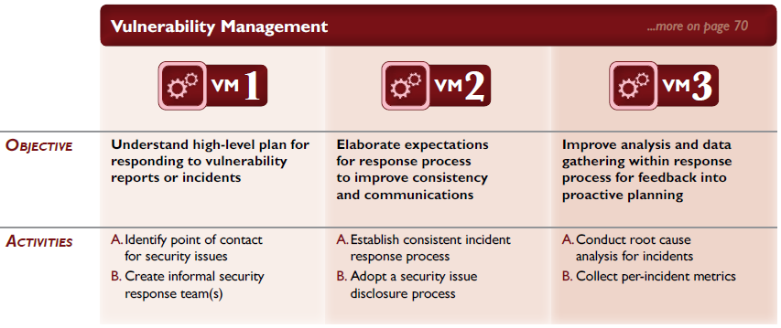
Software Security Testing & Validation–2

Slide 10
Software Security Testing & Validation–2
Operational Enablement:
Focused on gathering security critical information from the project teams building software and communicating it to the users and operators of the software.

Slide 11
Software Security Testing & Validation–2
Operational Enablement:
Without this information, even the most securely designed software carries undue risks since important security characteristics and choices will not be known at a deployment site.

Slide 12
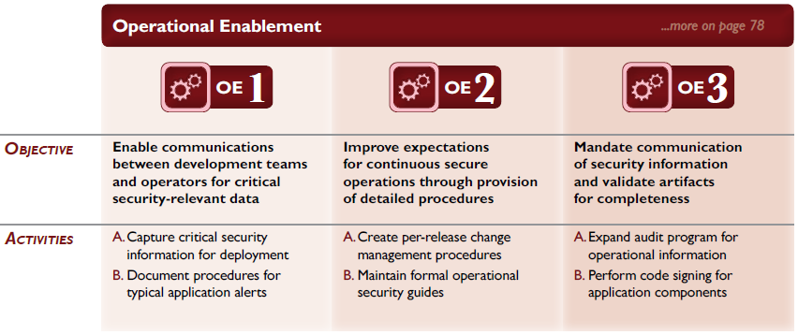
Software Security Testing & Validation–2

Slide 13
Software Security Testing & Validation–2
SAMM is an excellent model for software (security) assurance
OWASP also has a multitude of additional materials, guidance, and tools for software and seb application security
END

